Slide 1
RISC-V Decision Making and Logical Operations

Slide 2


Slide 3
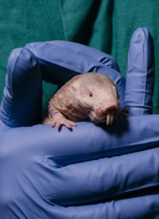
THE ANIMAL TRANSLATORS
“Researchers are using machine learning (ML) systems to decode animal communication. Scientists at Germany's Max Planck Institute for Brain Research used ML algorithms to analyze 36,000 mole rat chirps in seven colonies, identifying unique vocal signatures for each mole rat, as well as a distinct dialect for each colony. The multi-institutional Project CETI (Cetacean Translation Initiative) hopes to decipher the communication of sperm whales through the efforts of ML specialists, marine biologists, roboticists, linguists, and cryptographers. The project will involve recording whale sounds and movements via underwater microphones, robotic fish, and acoustic tags. Other projects aim to build technologies that enable human-animal communication, with Hunter College's Diana Reiss envisioning "a Google Translate for animals.”
www.nytimes.com/2022/08/30/science/translators-animals-naked-mole-rats.html

Slide 4
Review
Memory is byte-addressable, but lw and sw access one word at a time.
A pointer (used by lw and sw) is just a memory address, we can add to it or subtract from it (using offset).
Big- vs Little Endian
Tip: draw lowest byte on the right
New Instructions:
lw, sw, lb, sb, lbu

Slide 5
Decision Making

Slide 6
RV32 So Far…
Addition/subtraction
add rd, rs1, rs2
sub rd, rs1, rs2
Add immediate
addi rd, rs1, imm
Load/store
lw rd, rs1, imm
lb rd, rs1, imm
lbu rd, rs1, imm
sw rs1, rs2, imm
sb rs1, rs2, imm
Notes:
Each kernel has a register footprint
And note that register use can be optimized better than I did before

Slide 7
Computer Decision Making
Based on computation, do something different
In programming languages: if-statement
RISC-V: if-statement instruction is
beq reg1,reg2,L1
means: go to statement labeled L1 if (value in reg1) == (value in reg2)
….otherwise, go to next statement
beq stands for branch if equal
Other instruction: bne for branch if not equal

Slide 8
Types of Branches
Branch – change of control flow
Conditional Branch – change control flow depending on outcome of comparison
branch if equal (beq) or branch if not equal (bne)
Also branch if less than (blt) and branch if greater than or equal (bge)
And unsigned versions (bltu, bgeu)
Unconditional Branch – always branch
a RISC-V instruction for this: jump (j), as in j label

Slide 9
Example if Statement
Assuming translations below, compile if block
f → x10 g → x11 h → x12
i → x13 j → x14
if (i == j) bne x13,x14,Exit
f = g + h; add x10,x11,x12
Exit:
May need to negate branch condition

Slide 10
Example if-else Statement
Assuming translations below, compile
f → x10 g → x11 h → x12
i → x13 j → x14
if (i == j) bne x13,x14,Else
f = g + h; add x10,x11,x12
else j Exit
f = g – h; Else:sub x10,x11,x12
Exit:

Slide 11
Magnitude Compares in RISC-V
General programs need to test < and > as well.
RISC-V magnitude-compare branches:
“Branch on Less Than”
Syntax: blt reg1,reg2, Label
Meaning: if (reg1 < reg2) goto Label;
“Branch on Less Than Unsigned”
Syntax: bltu reg1,reg2, Label
Meaning: if (reg1 < reg2)// treat registers as unsigned integers goto label;
Also “Branch on Greater or Equal” bge and bgeu Note: No ‘bgt’ or ‘ble’ instructions

Slide 12
Loops in C/Assembly
There are three types of loops in C:
while
do … while
for
Each can be rewritten as either of the other two, so the same branching method can be applied to these loops as well.
Key concept: Though there are multiple ways of writing a loop in RISC-V, the key to decision-making is conditional branch

Slide 13
C Loop Mapped to RISC-V Assembly
int A[20];
// fill A with data
int sum = 0;
for (int i=0; i < 20; i++)
sum += A[i];
add x9, x8, x0 # x9=&A[0]
add x10, x0, x0 # sum=0
add x11, x0, x0 # i = 0
addi x13,x0, 20 # x13 = 20
Loop:
bge x11,x13,Done
lw x12, 0(x9) # x12=A[i]
add x10,x10,x12 # sum+=x12
addi x9, x9,4 # &A[i+1]
addi x11,x11,1 # i++
j Loop
Done:

Slide 14
Logical Instructions

Slide 15
RV32 So Far…
Add/sub
add rd, rs1, rs2
sub rd, rs1, rs2
Add immediate
addi rd, rs1, imm
Load/store
lw rd, rs1, imm
lb rd, rs1, imm
lbu rd, rs1, imm
sw rs1, rs2, imm
sb rs1, rs2, imm
Branching
beq rs1, rs2, Label
bne rs1, rs2, Label
bge rs1, rs2, Label
blt rs1, rs2, Label
bgeu rs1, rs2, Label
bltu rs1, rs2, Label
j Label
Notes:
Each kernel has a register footprint
And note that register use can be optimized better than I did before

Slide 16
RISC-V Logical Instructions
Useful to operate on fields of bits within a word
e.g., characters within a word (8 bits)
Operations to pack /unpack bits into words
Called logical operations
Logical operations | C operators | Java operators | RISC-V instructions
Bit-by-bit AND | & | & | and
Bit-by-bit OR | | | | | or
Bit-by-bit XOR | ^ | ^ | xor
Shift left logical | << | << | sll
Shift right logical | >> | >> | srl

Slide 17
RISC-V Logical Instructions
Always two variants
Register: and x5, x6, x7 # x5 = x6 & x7
Immediate: andi x5, x6, 3 # x5 = x6 & 3
Used for ‘masks’
andi with 0000 00FF_{hex} isolates the least significant byte
andi with FF00 0000_{hex} isolates the most significant byte

Slide 18
No NOT in RISC-V
There is no logical NOT in RISC-V
Use xor with 11111111_{two}
Remember - simplicity…
x | y | XOR(x,y)
0 | 0 | 0
0 | 1 | 1
1 | 0 | 1
1 | 1 | 0

Slide 19
Logical Shifting
Shift Left Logical (sll) and immediate (slli): slli x11,x12,2 #x11=x12<<2
Store in x11 the value from x12 shifted by 2 bits to the left (they fall off end), inserting 0’s on right; << in C.
Before: 0000 0002_{hex} 0000 0000 0000 0000 0000 0000 0000 0010_{two}
After: 0000 0008_{hex} 0000 0000 0000 0000 0000 0000 0000 1000_{two}
What arithmetic effect does shift left have?
Shift Right: srl is opposite shift; >>

Slide 20
Arithmetic Shifting
Shift right arithmetic (sra, srai) moves n bits to the right (insert high-order sign bit into empty bits)
For example, if register x10 contained
1111 1111 1111 1111 1111 1111 1110 0111_{two}= -25_{ten}
If execute srai x10, x10, 4, result is:
1111 1111 1111 1111 1111 1111 1111 1110_{two}= -2_{ten}
Unfortunately, this is NOT same as dividing by 2^{n}
Fails for odd negative numbers
C arithmetic semantics is that division should round towards 0
Notes:
\

Slide 21
A Bit About Machine Program

Slide 22
Assembler to Machine Code (More Later in Course)
Assembler source files (text)
foo.S
bar.S
Assembler converts human-readable assembly code to instruction bit patterns
Assembler
Assembler
foo.o
bar.o
Machine code object files
Linker
lib.o
a.out
Pre-built object file libraries
Machine code executable file

Slide 23
How Program is Stored
Memory
Program
Bytes
One RISC-V Instruction = 32 bits
Data

Slide 24
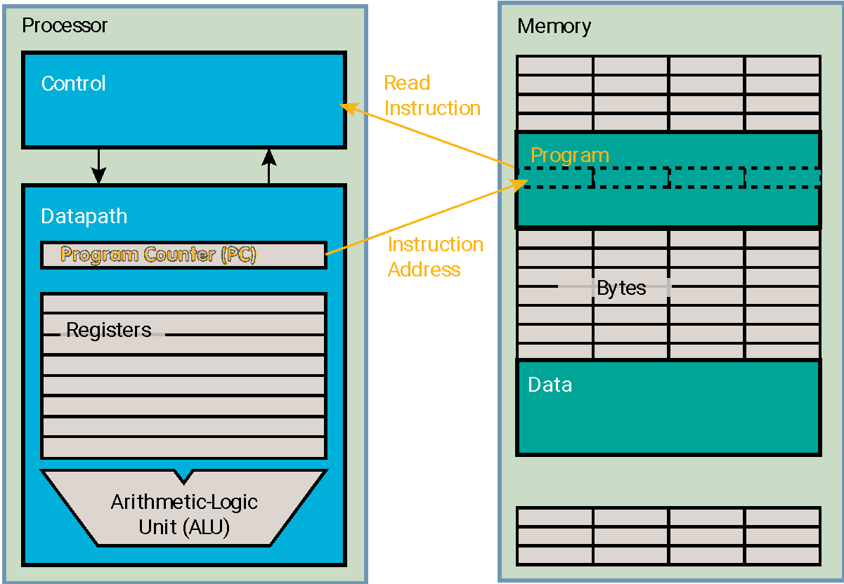
Program Execution
PC (program counter) is a register internal to the processor that holds byte address of next instruction to be executed
Instruction is fetched from memory, then control unit executes instruction using datapath and memory system, and updates PC (default add +4 bytes to PC, to move to next sequential instruction; branches, jumps alter)

Slide 25
Helpful RISC-V Assembler Features
Symbolic register names
E.g., a0-a7 for argument registers (x10-x17) for function calls
E.g., zero for x0
Pseudo-instructions
Shorthand syntax for common assembly idioms
E.g., mv rd, rs = addi rd, rs, 0
E.g., li rd, 13 = addi rd, x0, 13
E.g., nop = addi x0, x0, 0

Slide 26
Example: Translate *x = *y
We want to translate *x = *y into RISC-V
x, y ptrs stored in: x3 x5
1: add x3, x5, zero
2: add x5, x3, zero
3: lw x3, 0(x5)
4: lw x5, 0(x3)
5: lw x8, 0(x5)
6: sw x8, 0(x3)
7: lw x5, 0(x8)
8: sw x3, 0(x8)
1
2
3
4
5→6
6→5
7→8
Notes:
X11 = 03 f5
X5 = address

Slide 27
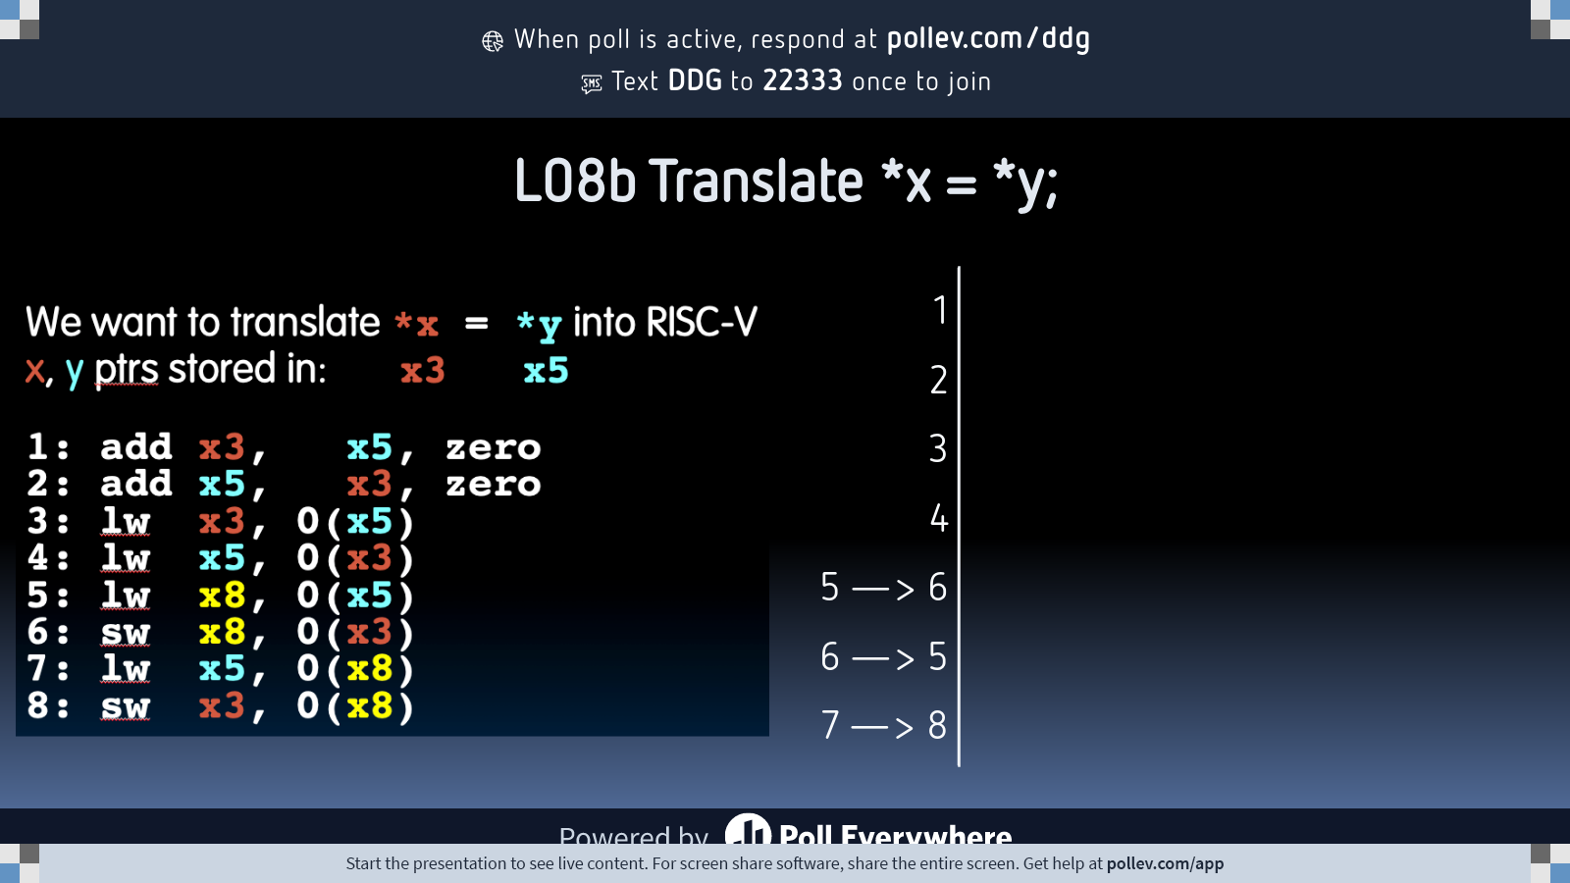
Notes:
Do not modify the notes in this section to avoid tampering with the Poll Everywhere activity. More info at polleverywhere.com/support L08b Translate *x = *y;
https://www.polleverywhere.com/multiple_choice_polls/FrOXvrvUCq453BpOGasn1?state=opened&flow=Default&onscreen=persist

Slide 28
Your Turn. What is in x12?
x10 holds 0x34FF
slli x12,x10,0x10
srli x12,x12,0x08
and x12,x12,x10
0x0
0x3400
0x4F0
0xFF00
0x34FF

Slide 29
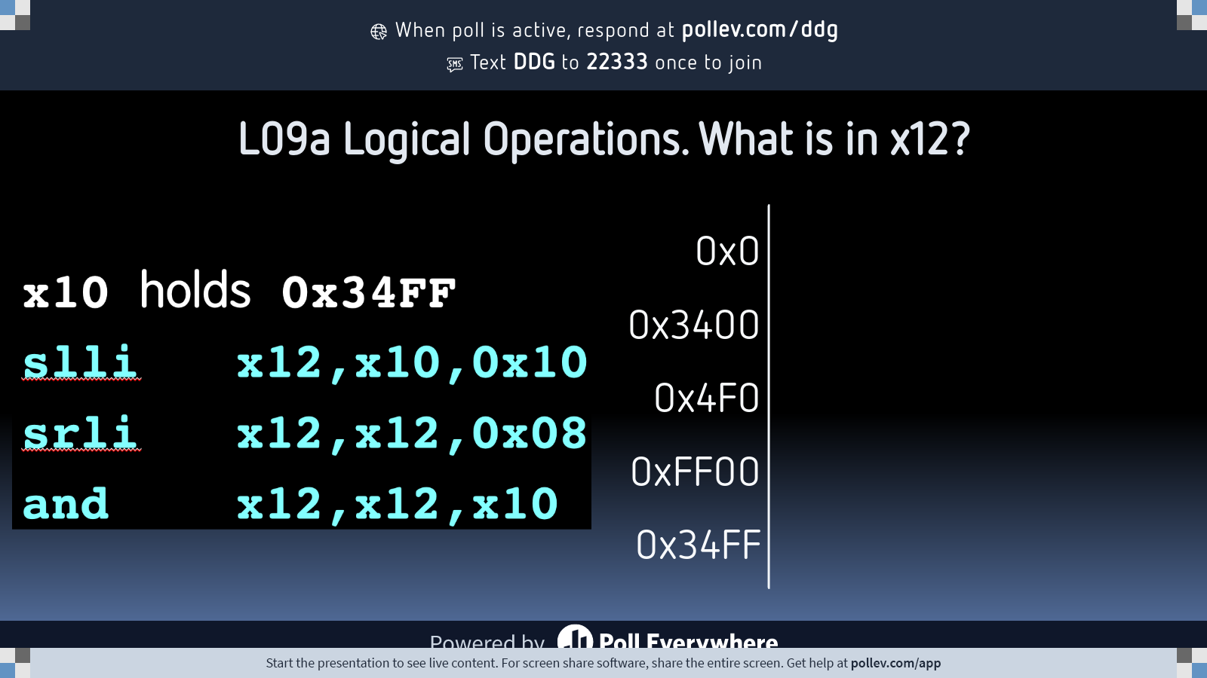
Notes:
Do not modify the notes in this section to avoid tampering with the Poll Everywhere activity. More info at polleverywhere.com/support L09a Logical Operations. What is in x12?
https://www.polleverywhere.com/multiple_choice_polls/Nn6PT0sflAy4tC9vvB4j5?state=opened&flow=Default&onscreen=persist

